Slide 1
Operating Systems
Chapter 8 Virtual Memory(虚拟内存)

Slide 2
Agenda
8.1 Hardware and Control Structure
8.2 Operating System Software
8.3 Summary

Slide 3
8.1 Hardware and Control Structure
8.1.0 Overview
8.1.1 Locality and Virtual Memory
8.1.2 Paging
8.1.3 Segmentation
8.1.4 Combined Paging and Segmentation
8.1.5 Protection and Sharing

Slide 4
Hardware and Control Structures
Memory references are dynamically translated into physical addresses at run time(运行时访问地址动态转换)
  A process may be swapped in and out (换入和换出) of main memory such that it occupies different regions
A process may be broken up into pieces that do not need to located contiguously in main memory(进程分块)
  All pieces of a process do not need to be loaded in main memory during execution(部分载入)
Notes:
Contiguously 连续的

Slide 5
Execution of a Program(程序运行)
Operating system brings into main memory a few pieces of the program
Resident set(常驻集) - portion of process that is in main memory
When an address is needed that is not in main memory:
  1. An interrupt is generated, which is known as page fault interrupt(缺页中断)
  2. Operating system places the process in a blocking state

Slide 6
Execution of a Program
  3. Piece of process that contains the logical address is brought into main memory
    Operating system issues a disk I/O Read request
    Another process is dispatched to run while the disk I/O takes place
    An interrupt is issued when disk I/O complete
  4. operating system place the affected process in the Ready state

Slide 7
Advantages of Breaking up a Process(进程分块的优点)
More processes may be maintained in main memory(主存中保留多个进程)
  Only load in some of the pieces of each process
  With so many processes in main memory, it is very likely a process will be in the Ready state at any particular time
A process may be larger than all of main memory(支持大于主存的进程)
Notes:
任何时候都有一个进程处于就绪状态

Slide 8
Types of Memory(存储器类型)
Real memory(实存)
  Main memory, the memory provided by computer hardware
Virtual memory(虚存)
  The memory to programmer’s view
  Allows for effective multiprogramming
  Relieves the user of tight constraints of main memory (解除了用户与主存之间的紧密约束)
Notes:
允许更有效的多道程序设计

Slide 9
Thrashing(系统抖动/系统颠簸)
Thrashing
  Swapping out a piece of a process just before that piece is needed
  Too much of this operations may leads the processor spends most of its time swapping pieces rather than executing user instructions

Slide 10
8.1 Hardware and Control Structure
8.1.0 Overview
8.1.1 Locality局部性 and Virtual Memory
8.1.2 Paging
8.1.3 Segmentation
8.1.4 Combined Paging and Segmentation
8.1.5 Protection and Sharing

Slide 11
Principle of Locality(局部性原理)
Program and data references within a process tend to cluster(程序和数据访问的集簇倾向)
Only a few pieces of a process will be needed over a short period of time
Possible to make intelligent guesses about which pieces will be needed in the future
This suggests that virtual memory may work efficiently

Slide 12
Support Needed for Virtual Memory
Hardware：
  support paging and segmentation (硬件要支持分页和分段)
Software：
  Operating system must be able to management the movement of pages and/or segments between secondary memory and main memory (操作系统要实现内存管理，使得段/页可以在内存与辅存之间移动)

Slide 13
8.1 Hardware and Control Structure
8.1.0 Overview
8.1.1 Locality and Virtual Memory
8.1.2 Paging
8.1.3 Segmentation
8.1.4 Combined Paging and Segmentation
8.1.5 Protection and Sharing

Slide 14
Paging(分页)
Each process has its own page table(页表)
Each page table entry(页表项) contains the frame number of the corresponding page in main memory
Present Bit(存在位):
  A bit is needed to indicate whether the page is in main memory or not
  If not in memory, a page fault interrupt will be generated

Slide 15
Paging(分页)
Modified Bit(修改位):
  A bit may be needed to indicate whether the page has been modified or not since it was loaded in main memory
  If no change has been made, the page does not have to be written to the disk when it needs to be swapped out(换出)

Slide 16
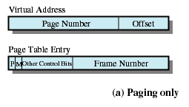
Page Table Structure
Notes:
纯分页，P存在位，M修改位

Slide 17
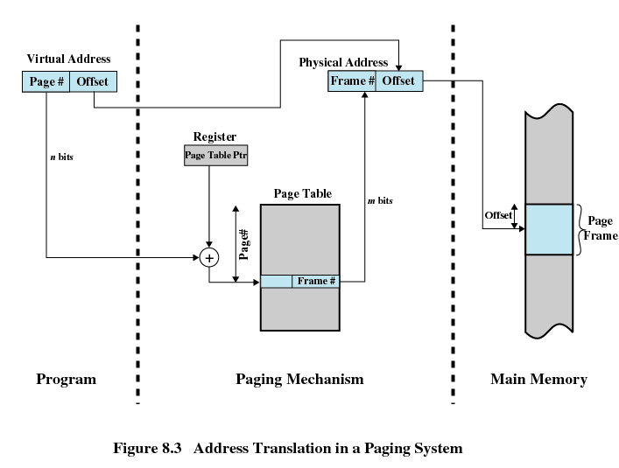
Address Translation in a Paging System(地址转换系统)
Notes:
N位，M位， 虚拟地址可不同于物理地址

Slide 18
Page Tables(页表)
The entire page table size is proportional to that of the virtual address space, and may take up too much main memory(页表大小与虚拟地址空间成比例增加，可能会很大)
Page tables are also stored in virtual memory(页表自身在虚存)
When a process is running, part of its page table is in main memory(部分页表在主存)
Notes:
proportional 成比例的

Slide 19
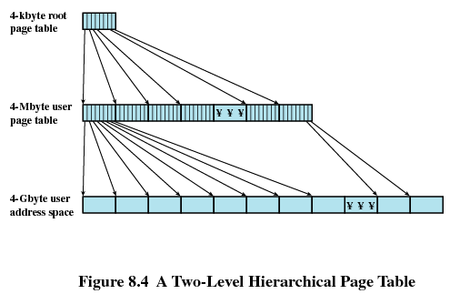
Two-Level Scheme for 32-bit Address(32位地址的两级页表方案)

Slide 20
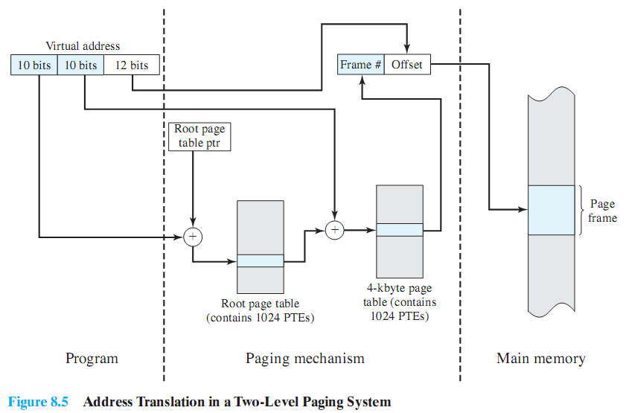
Two-Level Scheme for 32-bit Address(32位地址的两级页表方案)
页表项
Notes:
Ptes页表项

Slide 21
Inverted Page Table(反向页表)
Used on PowerPC, UltraSPARC, and IA-64 architecture
Page number portion of a virtual address is mapped into a hash value
Hash value points to inverted page table
Fixed proportion of real memory is required for the tables regardless of the number of processes or virtual pages supported
Notes:
Page number portion 页码部分 Fixed proportion 固定比例;

Slide 22
Inverted Page Table
Page table entry
  Page number(页号)
  Process identifier(进程标志符)
  Control bits(控制位)
  Chain pointer(链指针)

Slide 23
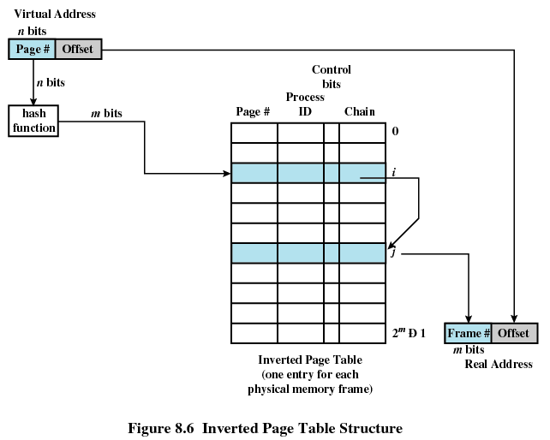
Inverted Page Table Structure
Notes:
在分页系统中为每个进程配置一张页表，进程逻辑地址空间中的每一页，在页表中都对应有一个页表项。在现代计算机系统中通常允许一个进程的逻辑地址空间非常大，因此就有很多页表项，从而占用很多的内存空间。为了减少页表占用的内存空间而引入了反置页表(Inverted Page Table)。一般页表的表项是按页号进行排序，页表项中的内容是物理块号。而倒置页表是为每一个物理块设置一个页表项并将按物理块号排序，其中的内容则是页号及其隶属进程的标志符。
在利用反置页表进行地址变换时，是用进程标志符和页号去检索反置页表；若检索完整个页表都未找到与之匹配的页表项，表明此页此时尚未调入内存，对于具有请求调页功能的存储器系统应产生请求调页中断，若无此功能则表示地址出错；如果检索到与之匹配的表项，则该表项的序号i便是该页所在的物理块号，将该块号与页内地址一起构成物理地址。
虽然反置页表可以有效地减少页表占用的内存，然而该表中却只包含已经调入内存的页面，并未包含那些未调入内存的各个进程的页面，因而必须为每个进程建立一个外部页表(External Page Table)，该页表与传统页表一样，当所访问的页面在内存时并不访问这些页表，只是当不在主存时才使用这些页表。该页表中包含了页面在外存的物理位置，通过该页表可将所需要的页面调入内存。
由于在反置页表中是为每一个物理块设置一个页表项的，通常页表项的数目很大，从几千项到几万项，要利用进程标识符和页号去检索这样大的线性表是相当费时的。于是又利用一种Hash表来检索。
搜索反向页表结构核心的所有条目是效率低下的，因此我们使用哈希表（hash table）将虚拟地址（如果需要的话还可是地址空间/PID信息）映射到反向页表的索引。
当哈希值大量重复且数据量非常大时，其检索效率并没有Btree索引高的。

Slide 24
Translation Lookaside Buffer(转移后备缓冲器/旁视缓冲器)
Each virtual memory reference can cause two physical memory accesses
  One to fetch the page table
  One to fetch the data
To overcome this problem a high-speed cache is set up for page table entries
  Called a Translation Lookaside Buffer (TLB)
  Contains page table entries that have been most recently used

Slide 25
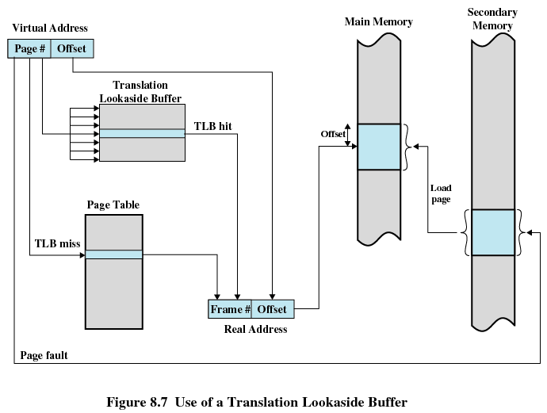
Use of a Translation Lookaside Buffer

Slide 26
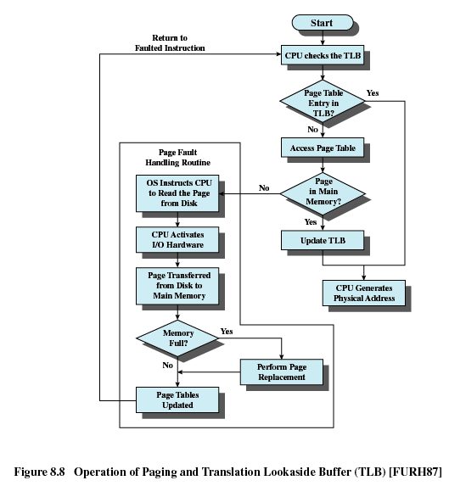

Slide 27
Work Flow of Translation Lookaside Buffer
Given a virtual address, processor examines the TLB
If page table entry is present (TLB hit), the frame number is retrieved and the real address is formed
If page table entry is not found in the TLB (TLB miss), the page number is used to index the process page table

Slide 28
Work Flow of Translation Lookaside Buffer
First checks if page is already in main memory
  If not in main memory a page fault is issued
The TLB is updated to include the new page entry

Slide 29
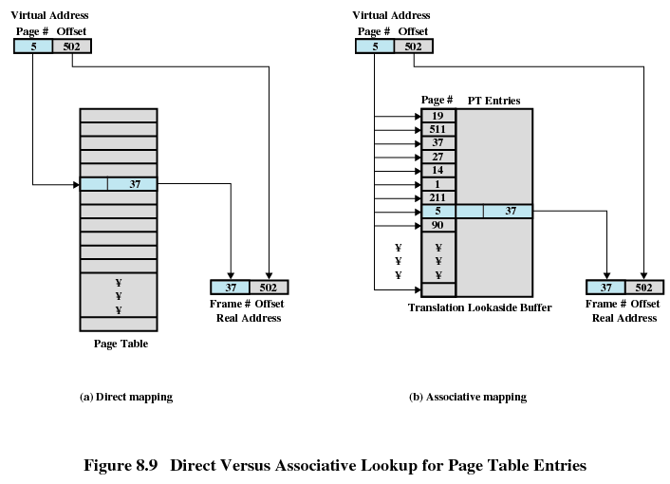
直接映射
关联映射

Slide 30
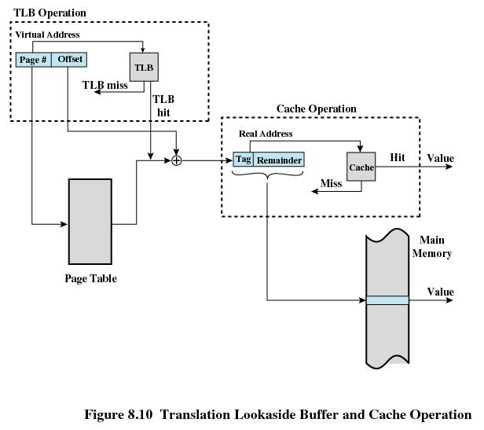
Notes:
页表在缓存，内存页在缓存

Slide 31
Page Size(页尺寸/页大小)
Smaller page size, less amount of internal fragmentation(页越小，内部碎片越少)
Smaller page size, more pages required per process，larger page tables(页越小，每个进程需要的页越多，进程的页表就越大)
Larger page tables means large portion of page tables in virtual memory (页表越大，占有用虚存越多)
Secondary memory is designed to efficiently transfer large blocks of data so a large page size is better
Notes:
大多数辅存设备的物理特性，希望页尺寸能比较大，从而实现更有效的数据块传送。

Slide 32
Page Size
Small page size, large number of pages will be found in main memory(页越小，进程在内存中的页越多). After a time, the pages in memory will all contain portions of the process near recent references. Page faults rate should be low.
Increased page size causes pages to contain locations further from any recent reference. The effect of locality is weakened. Page faults rate rises.
However the page fault rate will begin to fall as the size of page approaches a point.

Slide 33
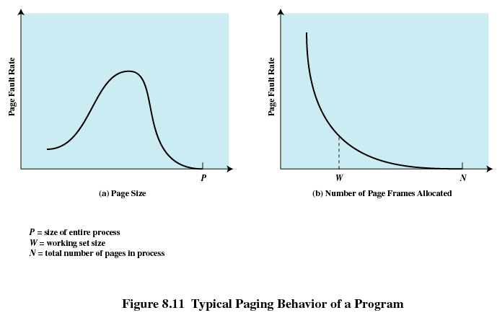

Slide 34
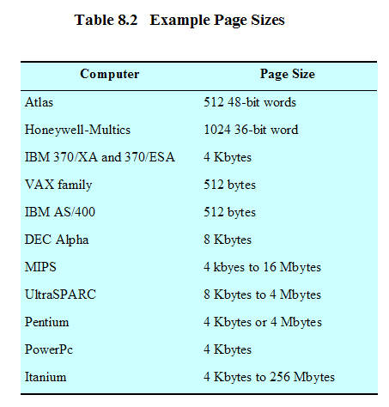
Example Page Sizes

Slide 35
8.1 Hardware and Control Structure
8.1.0 Overview
8.1.1 Locality and Virtual Memory
8.1.2 Paging
8.1.3 Segmentation
8.1.4 Combined Paging and Segmentation
8.1.5 Protection and Sharing

Slide 36
Segmentation(分段)
Segments may be of unequal, dynamic size (大小不等), advantages:
  Simplifies handling of growing data structures(简化不断增长的数据结构处理)
  Allows programs to be altered and recompiled independently (允许程序独立的修改和编译)
  Lends itself to sharing data among processes (有助于进程间共享)
  Lends itself to protection (有利于保护)
Notes:
边长数组

Slide 37
Segment Tables(段表)
Each process has its own segment table.
Each entry of segment table contains the length of the segment(段长) and segment base(段基址)
A bit is needed to determine if segment is already in main memory(存在位)
Another bit is needed to determine if the segment has been modified since it was loaded in main memory(修改位)

Slide 38
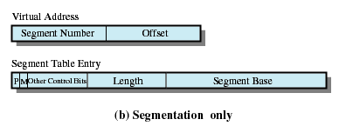
Segment Table Entries
段长
段基址

Slide 39
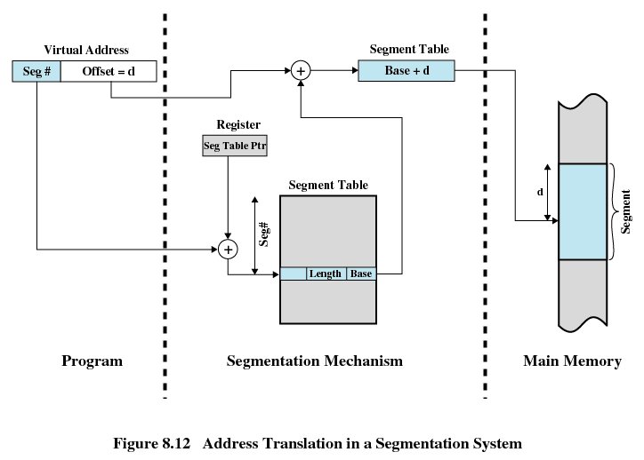

Slide 40
8.1 Hardware and Control Structure
8.1.0 Overview
8.1.1 Locality and Virtual Memory
8.1.2 Paging
8.1.3 Segmentation
8.1.4 Combined Paging and Segmentation
8.1.5 Protection and Sharing

Slide 41
Combined Paging and Segmentation
Each Process is broken up into a number of segments and each process has a segment table.
Each segment is, in turn broken up into a number of fixed-size pages, and each segment has a page table
Segmentation is visible to the programmer
Paging is transparent to the programmer

Slide 42
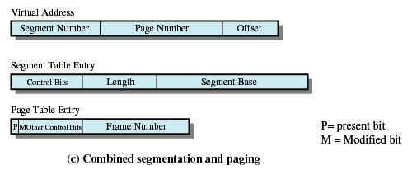
Combined Segmentation and Paging

Slide 43
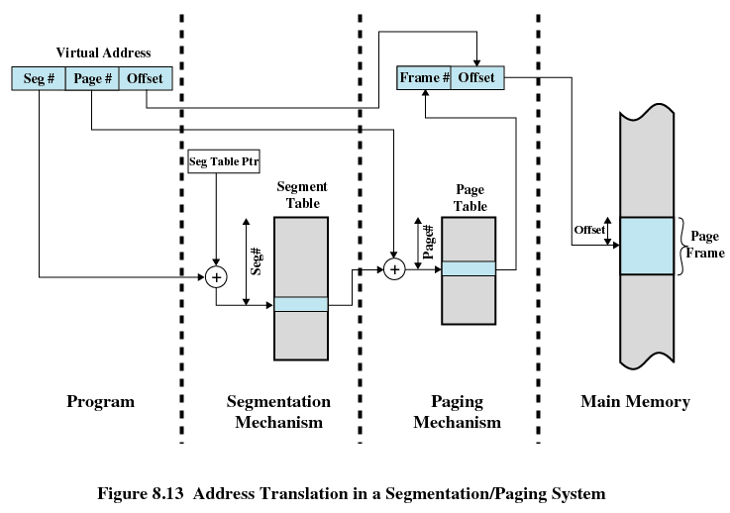

Slide 44
8.1 Hardware and Control Structure
8.1.0 Overview
8.1.1 Locality and Virtual Memory
8.1.2 Paging
8.1.3 Segmentation
8.1.4 Combined Paging and Segmentation
8.1.5 Protection and Sharing

Slide 45
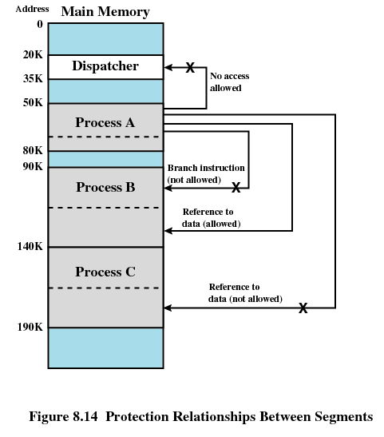

Slide 46
Agenda
8.1 Hardware and Control Structure
8.2 Operating System Software
8.3 Summary

Slide 47
8.2 Operating System Software
8.2.1 Fetch Policy
8.2.2 Placement Policy
8.2.3 Replacement Policy
8.2.4 Resident Set Management
8.2.5 Clearing Policy
8.2.6 Load Control

Slide 48
Fetch Policy(读取策略)
Fetch Policy: Determines when a page should be brought into memory
  Demand paging(请求分页式) only brings pages into main memory when a reference is made to a location on the page
    Many page faults when process first started
  Prepaging(预约分页式) brings in more pages than needed
    More efficient to bring in pages that reside contiguously on the disk
Notes:
开始会出现大量的缺页终端

Slide 49
8.2 Operating System Software
8.2.1 Fetch Policy
8.2.2 Placement Policy
8.2.3 Replacement Policy
8.2.4 Resident Set Management
8.2.5 Clearing Policy
8.2.6 Load Control

Slide 50
Placement Policy(放置策略)
Placement Policy: Determines where in real memory a process piece is to reside
  Important in a segmentation system and nonuniform memory access(NUMA, 非一致存储器访问) system (放置策略对分段系统和NUMA系统影响大)
  Paging or combined paging with segmentation hardware performs address translation and placement is usually irrelevant(放置策略对分页和段页式系统影响不大)
Notes:
放置策略决定一个进程块驻留在实存中的什么地方
但是访问某一特定的物理单元所需要的时间随着处理器和内存模块之间距离的不同而变化

Slide 51
8.2 Operating System Software
8.2.1 Fetch Policy
8.2.2 Placement Policy
8.2.3 Replacement Policy
8.2.4 Resident Set Management
8.2.5 Clearing Policy
8.2.6 Load Control

Slide 52
Replacement Policy(置换策略)
Placement Policy: Which page is replaced?
  Page removed should be the page least likely to be referenced in the near future（最近访问可能性最小的页）
  Most policies predict the future behavior on the basis of past behavior（基于过去的行为预测未来的行为）

Slide 53
Frame Locking(帧锁定)
Frame Locking
  If frame is locked, it may not be replaced, some examples:
    Kernel of the OS
    Important Control structures of OS
    I/O buffers
  Associate a lock bit with each frame

Slide 54
Basic Replacement Algorithms
1. Optimal policy( OPT, 最佳 )
  Selects for replacement that page for which the time to the next reference is the longest(下次访问距当前时间最长的页)
  Impossible to have perfect knowledge of future events

Slide 55
Basic Replacement Algorithms
2. Least Recently Used (LRU, 最近最少使用)
  Replaces the page that has not been referenced for the longest time(上次访问距当前时间最长的页)
  By the principle of locality, this should be the page least likely to be referenced in the near future
  Each page could be tagged with the time of last reference. This would require a great deal of overhead.
Notes:
给每一页添加一个最后一次访问的时间标签，并且必须在每次访问存储器时，都更新

Slide 56
Basic Replacement Algorithms
3. First-in, first-out (FIFO, 先进先出)
  Treats page frames allocated to a process as a circular buffer(把分配给进程的页帧看做是一个循环缓冲区)
  Pages are removed in round-robin(循环) style
  Simplest replacement policy to implement
  Page that has been in memory the longest is replaced
  These pages may be needed again very soon

Slide 57
Basic Replacement Algorithms
4. Clock Policy(时钟策略)
  Additional bit called a use bit(使用位)is association with every page
  When a page is first loaded in memory, the use bit is set to 1
  When the page is referenced, the use bit is set to 1
  When it is time to replace a page, the first frame encountered with the use bit set to 0 is replaced
  During the search for replacement, each use bit set to 1 is changed to 0

Slide 58
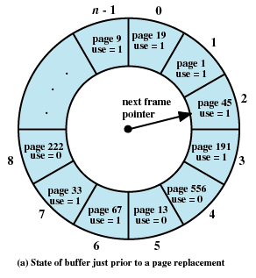
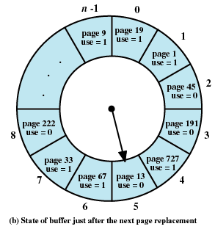

Slide 59
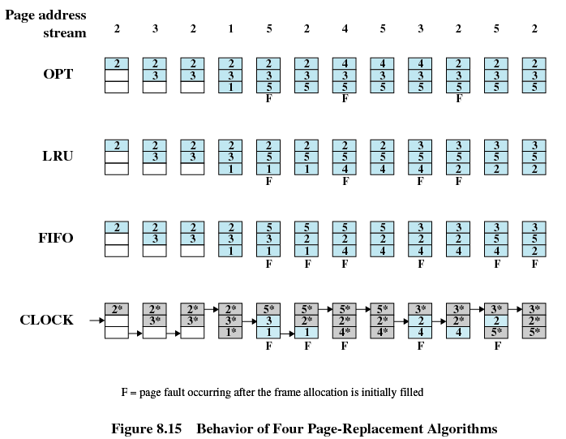
Notes:
注意：在clock算法中，深灰色表示“访问位”为“1”，浅蓝色表示“访问位”为”0“

Slide 60
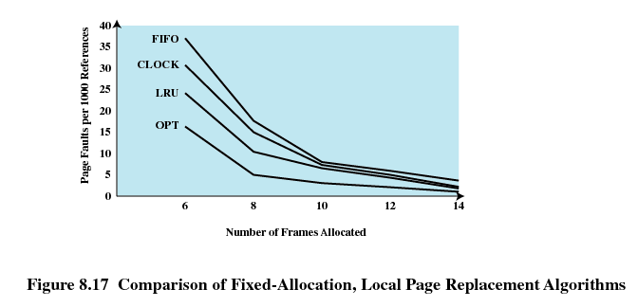
Comparison of Placement Algorithms
Notes:
适合的帧数在曲线的拐角处，既保证较少的页帧分配，也保证较少的缺页率

Slide 61
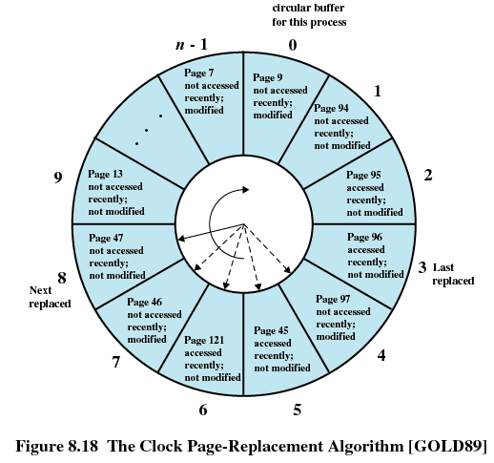
Clock Policy Using Use Bit and Modified Bit
Not accessed recently, not modified (u=0;m=0)
Not accessed recently, modified (u=0;m=1)
Accessed recently, not modified (u=1;m=0)
Accessed recently, modified (u=1;m=1)

Slide 62
Clock Policy Using Use Bit and Modify Bit
Beginning at the current position of the pointer, scan the frame buffer. During this scan, make no changes to the use bit. The first frame encountered with ( u = 0; m = 0) is selected for replacement.
If step 1 fails, scan again, looking for the frame with (u = 0; m = 1).The first such frame encountered is selected for replacement. During this scan, set the use bit to 0 on each frame that is bypassed.
If step 2 fails, the pointer should have returned to its original position and all of the frames in the set will have a use bit of 0. Repeat step 1 and, if necessary, step 2. This time, a frame will be found for the replacement.

Slide 63
Page Buffering(页缓冲)
Replaced page is added to one of two lists
  Free page list if page has not been modified (空闲页表)
  Modified page list (修改页表)
  Modified pages are written out in clusters rather than one at a time
Notes:
修改页表，空闲页表

Slide 64
8.2 Operating System Software
8.2.1 Fetch Policy
8.2.2 Placement Policy
8.2.3 Replacement Policy
8.2.4 Resident Set Management
8.2.5 Clearing Policy
8.2.6 Load Control

Slide 65
Resident Set Size(驻留集大小)
Fixed-allocation(固定分配)
  Gives a process a fixed number of pages within which to execute
  When a page fault occurs, one of the pages of that process must be replaced
Variable-allocation(可变分配)
  Number of pages allocated to a process varies over the lifetime of the process

Slide 66
Replace Scope(替换范围)
Local Replace Policy(局部置换)
  Chooses only among the resident pages of the process that generated the page fault in selecting a page to replace
Global Replace Policy(全局置换)
  Considers all unlocked pages in main memory as candidates for replacement, regardless of which process owns a particular page

Slide 67
Fixed Allocation, Local Scope(固定分配，局部置换)
Decide ahead of time the amount of allocation to give a process (事先确定给进程分配多少页)
If allocation is too small, there will be a high page fault rate (如果太少，导致高缺页率)
If allocation is too large there will be too few programs in main memory (如果分配太多，内存中驻留的程序会过少)

Slide 68
Variable Allocation, Global Scope(可变分配，全局置换)
Easiest to implement
Adopted by many operating systems
Operating system keeps list of free frames
Free frame is added to resident set of process when a page fault occurs
If no free frame, replaces one from any of the resident processes

Slide 69
Variable Allocation, Local Scope(可变分配，局部置换)
When new process added, allocate number of page frames based on application type, program request, or other criteria
When page fault occurs, select page from among the resident set of the process that suffers the fault
Reevaluate(重新评估) allocation of processes from time to time and increase or decrease allocation to improve overall performance

Slide 70
8.2 Operating System Software
8.2.1 Fetch Policy
8.2.2 Placement Policy
8.2.3 Replacement Policy
8.2.4 Resident Set Management
8.2.5 Clearing Policy
8.2.6 Load Control

Slide 71
Cleaning Policy(清除策略)
Demand cleaning(请求式清除)
  A page is written out only when it has been selected for replacement
Precleaning(预约式清除)
  Pages are written out in batches before they are needed

Slide 72
Cleaning Policy
Best approach uses page buffering
  Replaced pages are placed in two lists
    Modified and unmodified
  Pages in the modified list are periodically written out in batches
  Pages in the unmodified list are either
    reclaimed if referenced again
    or lost when its frame is assigned to another page

Slide 73
8.2 Operating System Software
8.2.1 Fetch Policy
8.2.2 Placement Policy
8.2.3 Replacement Policy
8.2.4 Resident Set Management
8.2.5 Clearing Policy
8.2.6 Load Control

Slide 74
Load Control(加载控制)
Determines the number of processes that will be resident in main memory
Too few processes, many occasions when all processes will be blocked and much time will be spent in idle or swapping
Too many processes will lead to thrashing
Notes:
Thrash 抖动

Slide 75
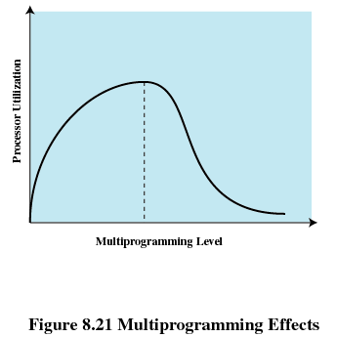
Multiprogramming Level(多道程序设计级)

Slide 76
Process Suspension(进程挂起)
Lowest priority process(最低优先级进程)
Faulting process(页错误进程)
  This process does not have its working set in main memory so it will be blocked anyway
Last process activated(最后被激活的进程)
  This process is least likely to have its working set resident

Slide 77
Process Suspension
Process with smallest resident set(驻留集最小的进程)
  This process requires the least future effort to reload
Largest process(占用空间最大的进程)
  Obtains the most free frames
Process with the largest remaining execution window(具有最大剩余执行窗口的进程)

Slide 78
Agenda
8.1 Hardware and Control Structure
8.2 Operating System Software
8.3 Summary

